Slide 1


Home Credit Default Risk Prediction Model
The University of Chicago
MACS 33002 Introduction to Machine Learning
Jun Lee
https://drive.google.com/file/d/1ywc8nOHgwtZXQN2yDpiI2pRCqO_xwCeN/view?usp=sharing

Slide 2

1. Introduction Financial stability is very important for a bank. A banking system fundamentally relies on debt, having people deposit their money, investing the money, lending the money to economic agents, and taking the interest back later. However, what if debtors cannot repay the money? A bank will be financially in danger. Hence, it is important to predict if a potential debtor can repay it before banks lend the money.

Slide 3
2. Goals
We perform unsupervised and supervised machine learning techniques to predict credit default risk:
For unsupervised learning:
We perform dimension reduction with PCA and T-SNE to reduce the data representation to lower dimensions.
We visualize data in the new lower feature space with PCA and T-SNE.
For supervised learning:
We train a binary classifier to predict whether an individual experiences financial distress in the next two years.
We experiment with four different models
A Decision Tree classifier
A Random Forest classifier
A Logistic Regression classifier
An Ensemble model
and compare their performances.
By interpreting feature coefficients, we extract features that are predictive of credit default risk.

Slide 4
3. Data Overview
150,000 individual credit data
Target Variable:
SeriousDlqin2yrs
10 Features (All numerical):
Revolving Utilization of Unsecured Lines
Age
Debt Ratio
Monthly Income
Number of Open Credit Lines and Loans
Number Real Estate Loans or Lines
Number of Dependents
Number Of Time 30-59 Days Past Due Not Worse
Number of Time 60-89 Days Past Due Not Worse
Number of Times 90 Days Late
Potential Credit Default risk
(1)
Potential Credit Default risk
(0)
Data source: https://www.kaggle.com/competitions/GiveMeSomeCredit/overview

Slide 5
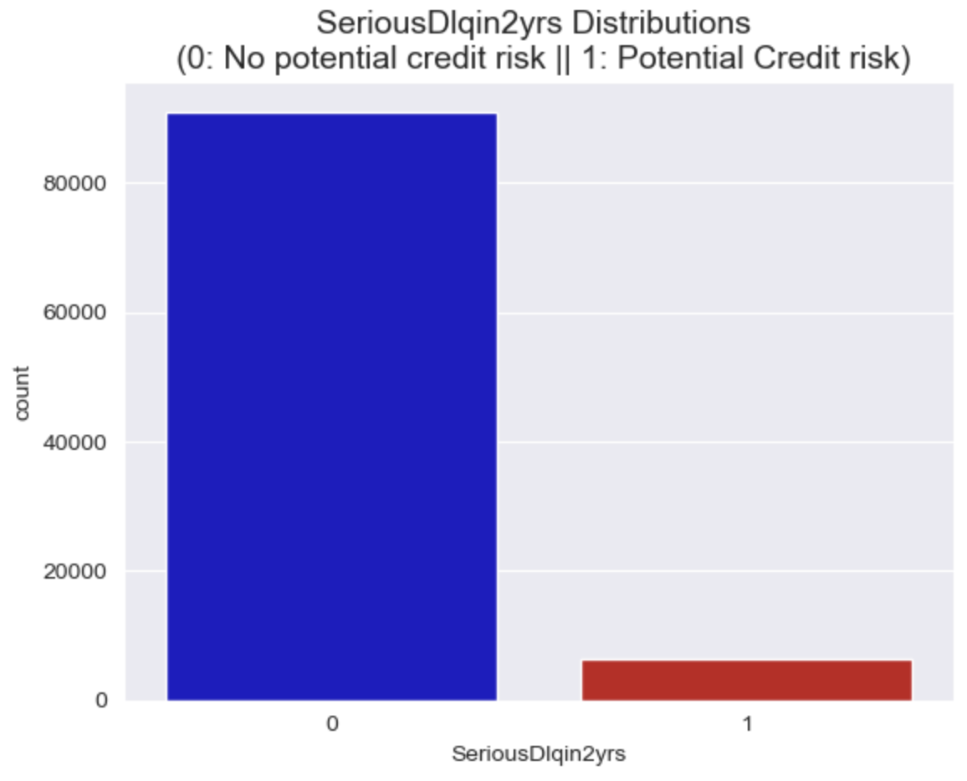
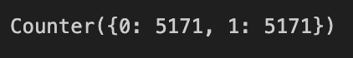
4. Data Cleaning
Results
150,000 -> 97,521 datapoints
Dropped 3 variables:
Number Of Time 30-59 Days Past Due Not Worse
Number of Time 60-89 Days Past Due Not Worse
Number of Times 90 Days Late
Remove outliers
Remove columns not useful
Feature scaling- Normalization
Balance the dataset

Slide 6
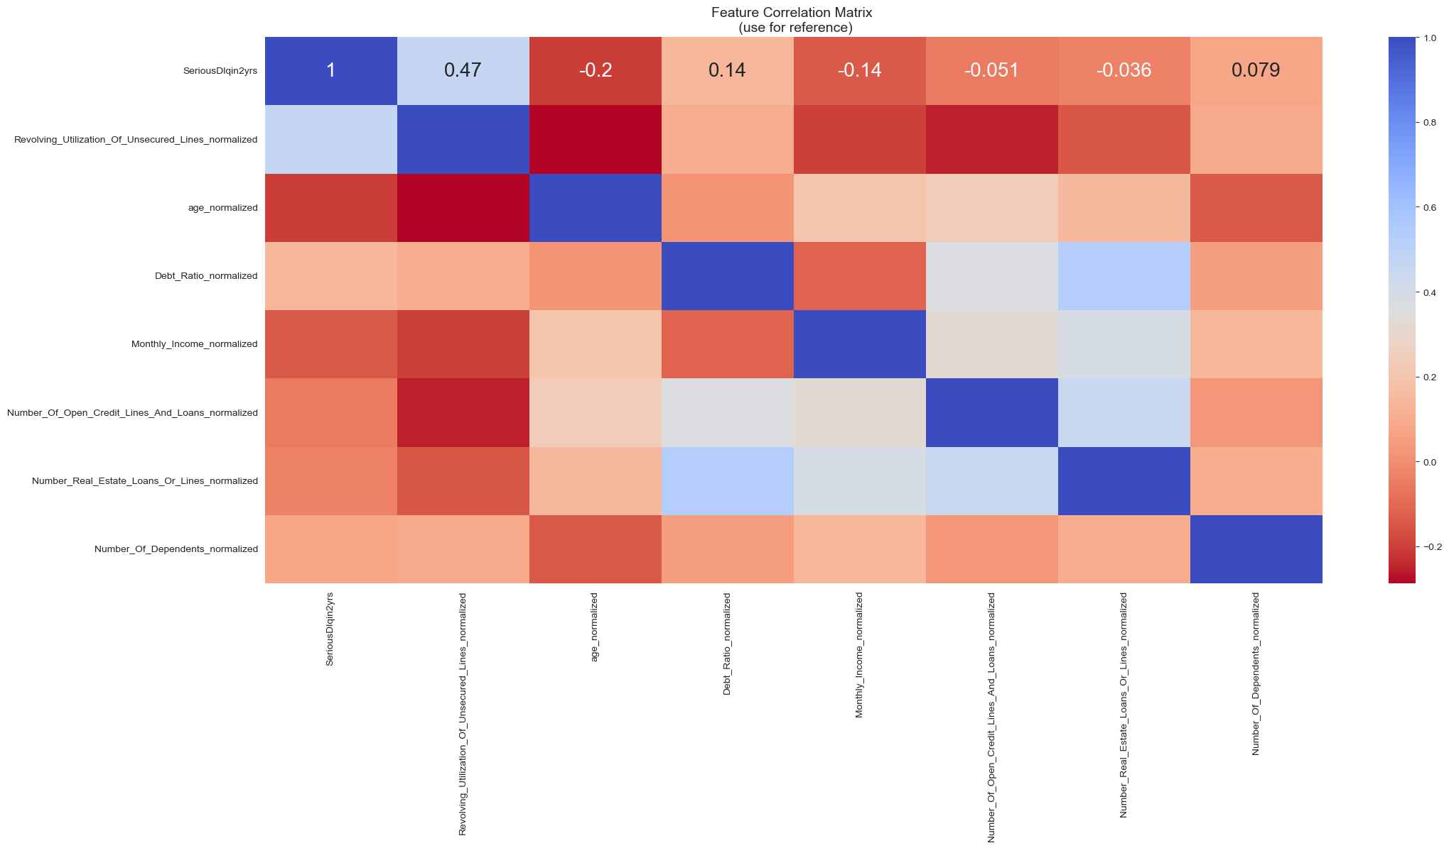
Correlations
Features | Corr
Revolving Utilization of Unsecured Lines | 0.47
Age | -0.2
Debt Ratio | 0.14
Monthly Income | -0.14
Number of Open Credit Lines and Loans | -0.051
Number Real Estate Loans or Lines | -0.036
Number of Dependents | 0.079

Slide 7
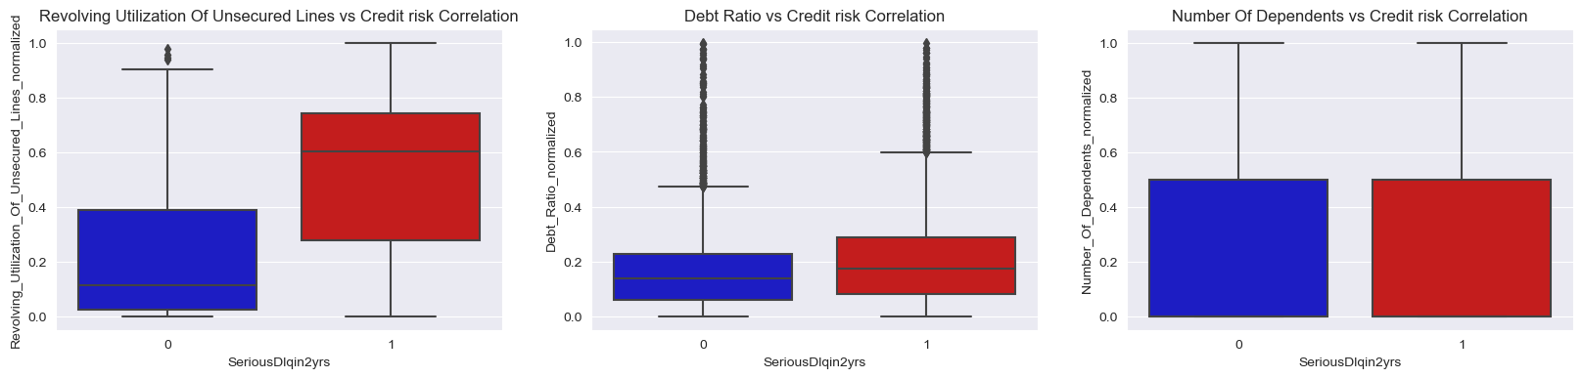
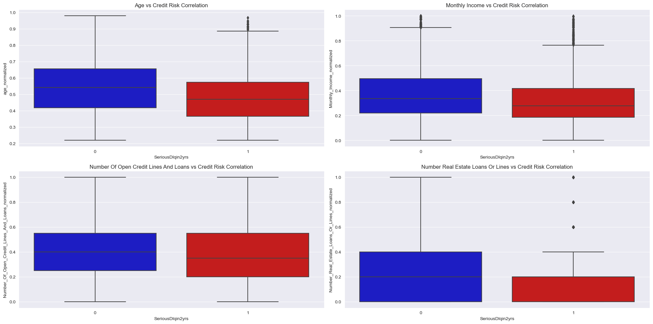
Positive Correlations
(The higher the feature value, the more likely it will be a credit risk)
Negative Correlations
(The lower the feature value, the more likely it will be a credit risk)

Slide 8
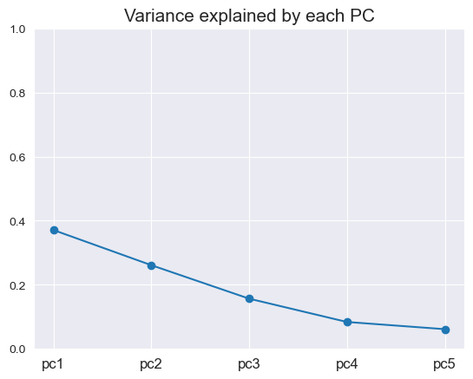
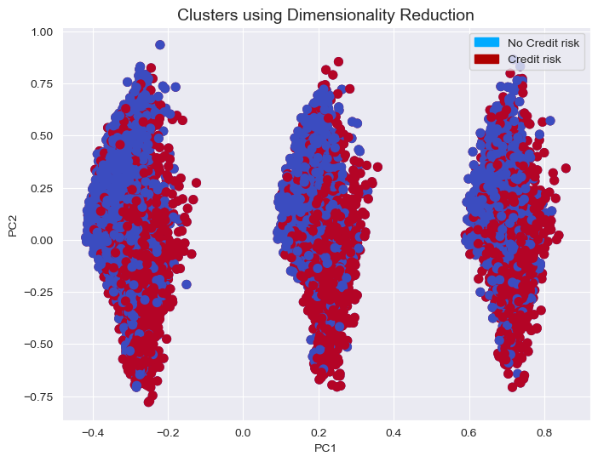
5. Unsupervised learning

Slide 9
6. Supervised learning
Decision tree
Random forest
Logistic regression
An ensemble model (bagging)

Slide 10
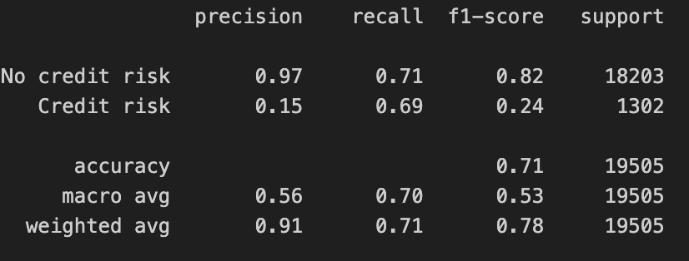
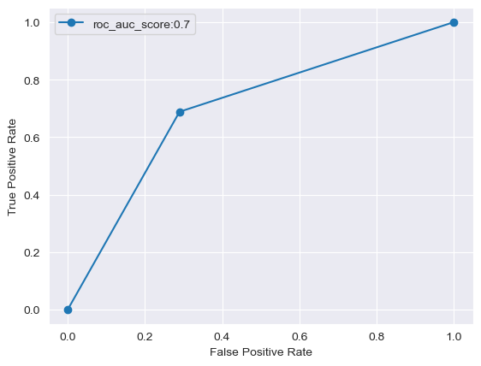
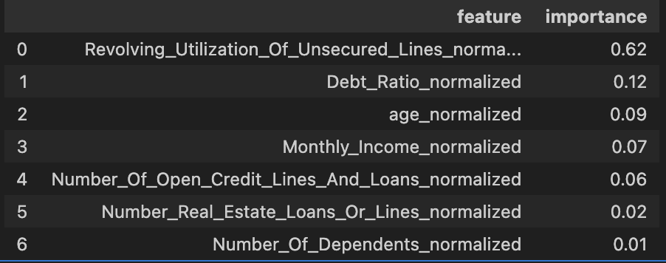
1) Decision Tree
Grid search CV
Best Parameters: {'max_depth': 10, 'min_samples_leaf': 1, 'min_samples_split': 10}
Best Score: 0.6858443655210518
ROC-AUC
: 0.699
Classification
report
Confusion matrix
TN | FP | FN | TP
896 | 406 | 5271 | 12932
Feature Importance

Slide 11
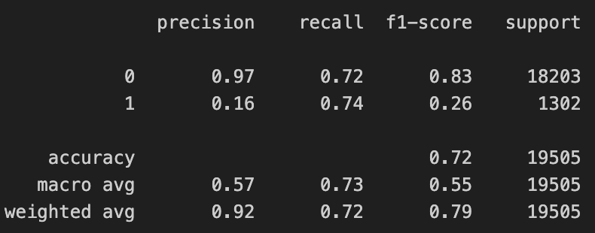
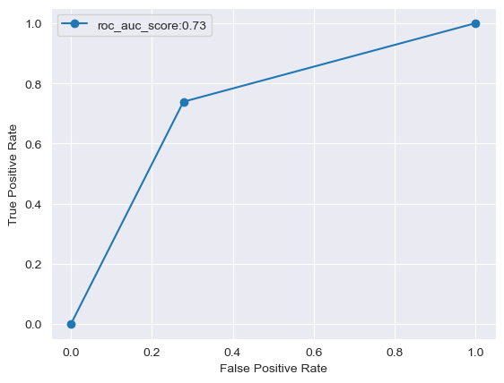
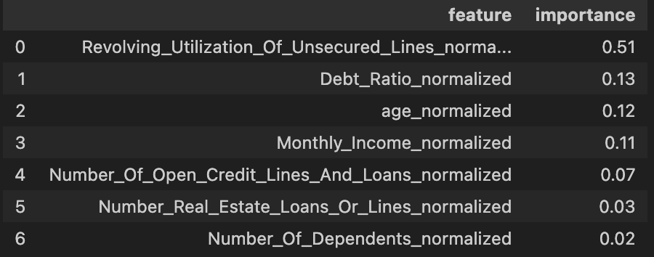
2) Random Forest
Grid search CV
Best Parameters: {'max_depth': 10, 'min_samples_leaf': 4, 'min_samples_split': 10, 'n_estimators': 500}
Best Score: 0.7838384973416115
ROC-AUC
: 0.730
Classification
report
Confusion matrix
TN | FP | FN | TP
962 | 340 | 5060 | 13143
Feature Importance

Slide 12
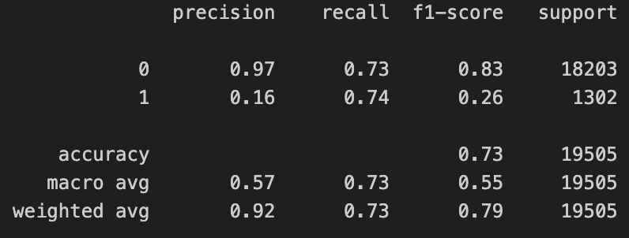
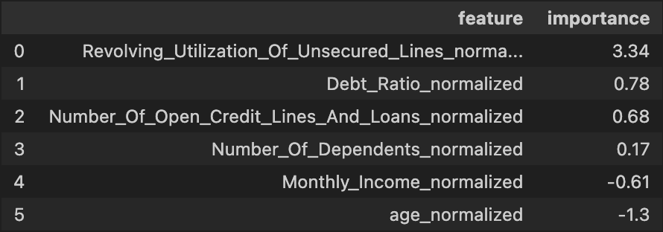
3) Logistic Regression
Grid search CV
Best Parameters: {'C': 0.1, 'penalty': 'l1', 'solver': 'liblinear'}
Best Score: 0.7174621122529969
ROC-AUC
: 0.731
Classification
report
Confusion matrix
TN | FP | FN | TP
960 | 342 | 4997 | 13206
Feature Importance

Slide 13
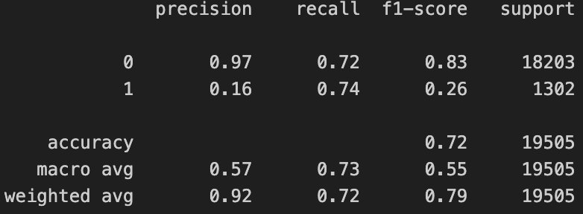
4) Ensemble model (bagging)
Grid search CV
Best parameters found: {'base_estimator__C': 1, 'bootstrap': True, 'max_features': 0.8, 'max_samples': 1.0, 'n_estimators': 20}
Best scores: 0.7187193188946528
Classification
report
Confusion matrix
ROC-AUC
: 0.729
TN | FP | FN | TP
959 | 343 | 5059 | 13144

Slide 14
7. Summary
 | Decision Tree | Random Forest | Logistic Regression | Ensemble model (Bagging)
Accuracy Score | 0.709 | 0.794 | 0.726 | 0.719
ROC Score | 0.699 | 0.730 | 0.731 | 0.729
number of errors | 5677 (FP: 406, FN: 5271) | 5400 (FP: 340, FN: 5060) | 5339 (FP: 342, FN: 4997) | 5402 (FP: 343, FN: 5059)
Top two important features: | Revolving Utilization Of Unsecured Lines (.62) | Revolving Utilization Of Unsecured Lines (.51) | Revolving Utilization Of Unsecured Lines (3.34)
 | Debt Ratio (.12) | Debt Ratio (.13) | Debt Ratio (.78)

Slide 15
Appendix. Data Dictionary
- Revolving Utilization of Unsecured Lines: Total balance on credit cards and personal lines of credit except real estate and no installment debt like car loans divided by the sum of credit limits (percentage)
- age: Age of borrower in years (integer)
- Number of Time 30-59 Days Past Due Not Worse: Number of times borrower has been 30-59 days past due but no worse in the last 2 years.(integer)
- Debt Ratio: Monthly debt payments, alimony, living costs divided by monthly gross income (percentage)
- Monthly Income: Monthly income (real)
- Number of Open Credit Lines and Loans: Number of Open loans (installment like car loan or mortgage) and Lines of credit (e.g. credit cards) (integer)
- Number of Times 90 Days Late: Number of times borrower has been 90 days or more past due. (integer)
- Number Real Estate Loans or Lines: Number of mortgage and real estate loans including home equity lines of credit (integer)
- Number of Time 60-89 Days Past Due Not Worse: Number of times borrower has been 60-89 days past due but no worse in the last 2 years. (integer)
- Number of Dependents: Number of dependents in family excluding themselves (spouse, children etc.) (integer)

